Slide 1
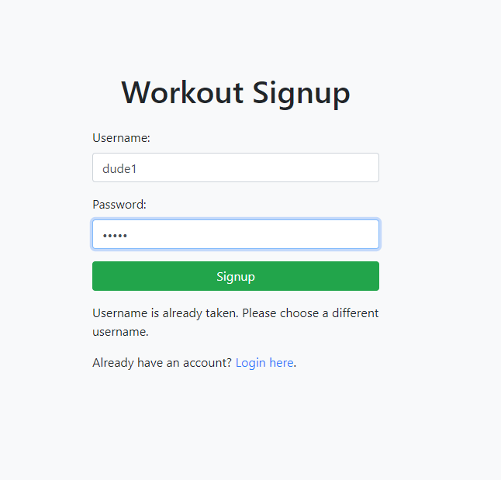
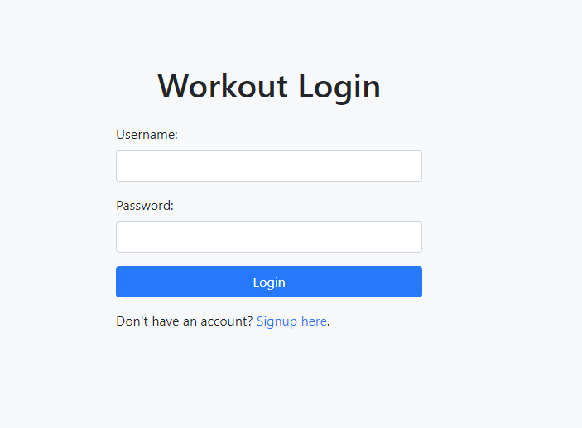
Workout Website

Slide 2
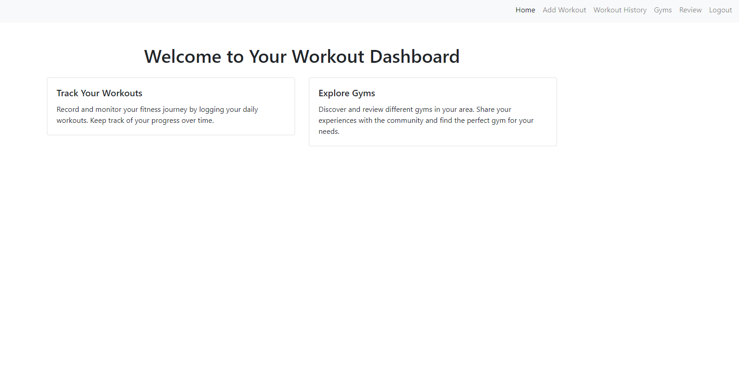
Welcome Page with a Navigation Bar

Slide 3
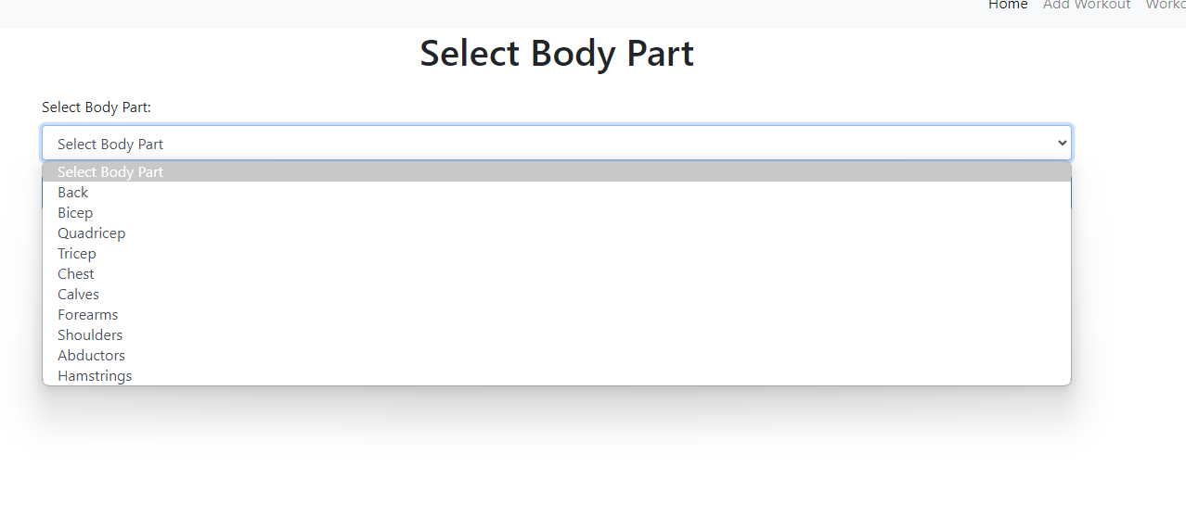
When adding a workout you pick a body part

Slide 4
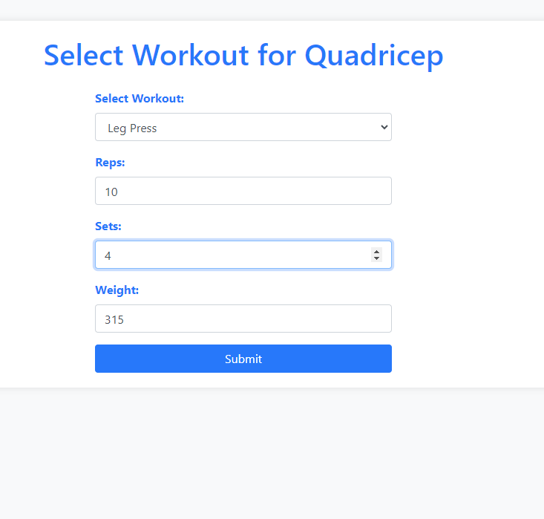
From that body part you will be given workouts that will focus that body part and enter sets reps and weight for the exercise

Slide 5
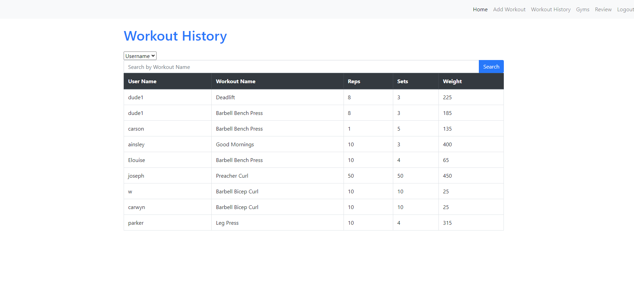
Then you can look at the workout history for all users

Slide 6
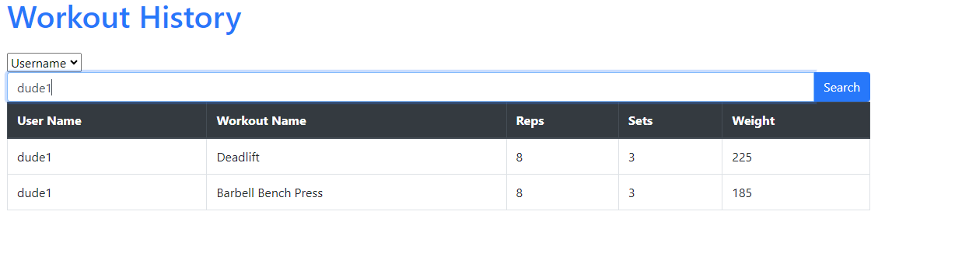
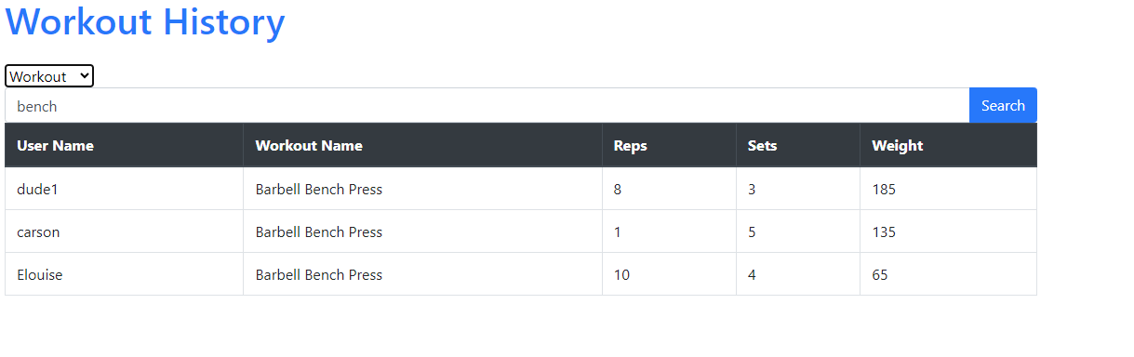
You can then do faceted search by username or by workout

Slide 7
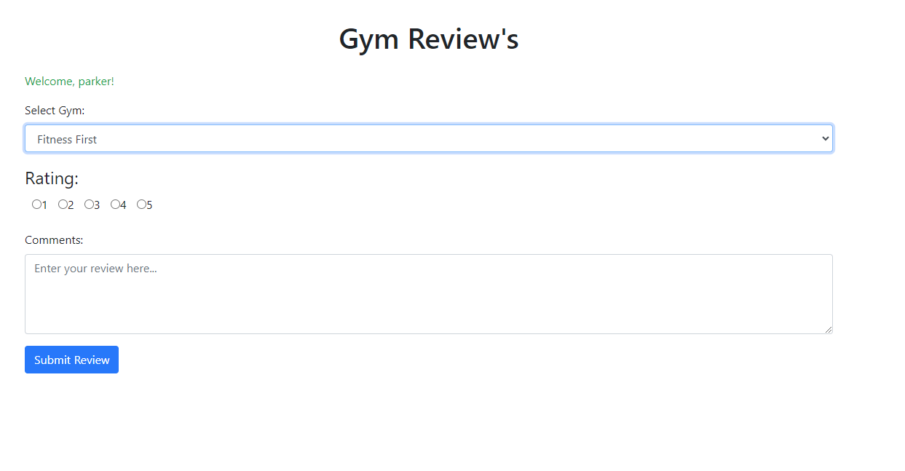

Slide 8
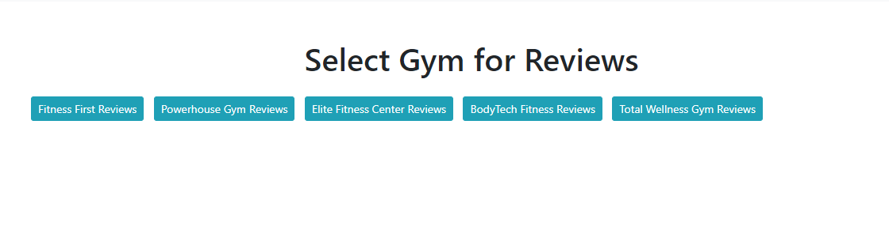
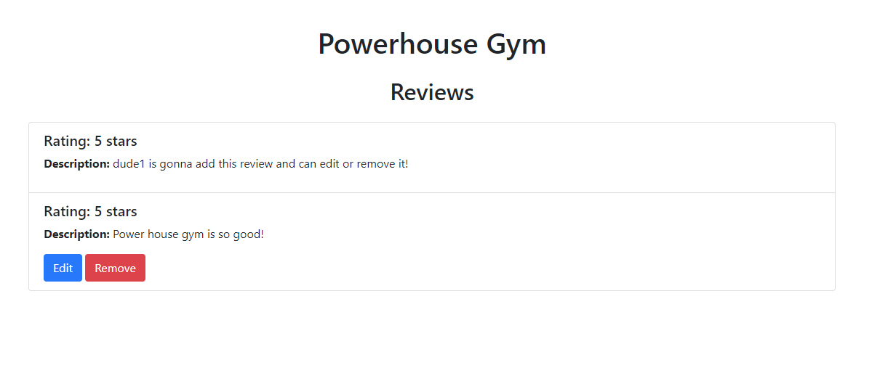
On the gym’s page you can select a gym to see the reviews for. You can edit and remove if you are the user that made the review

Slide 9
Some of the hard queries:
SELECT r.rating, r.description, r.review_id, g.gym_id, g.gym_name, ur.user_id FROM gym g JOIN gym_review gr USING (gym_id) JOIN reviews r ON gr.review_id = r.review_id JOIN user_review ur ON ur.review_id = r.review_id WHERE g.gym_id = ?
'DELETE FROM user_review WHERE review_id = ?'
'DELETE FROM gym_review WHERE review_id = ?'
'DELETE FROM reviews WHERE review_id = ?'
Trouble with this query was doing it in order without deleting a parent attribute
The hardest part of the queries was getting the information so doing a query inside of another one

Slide 10
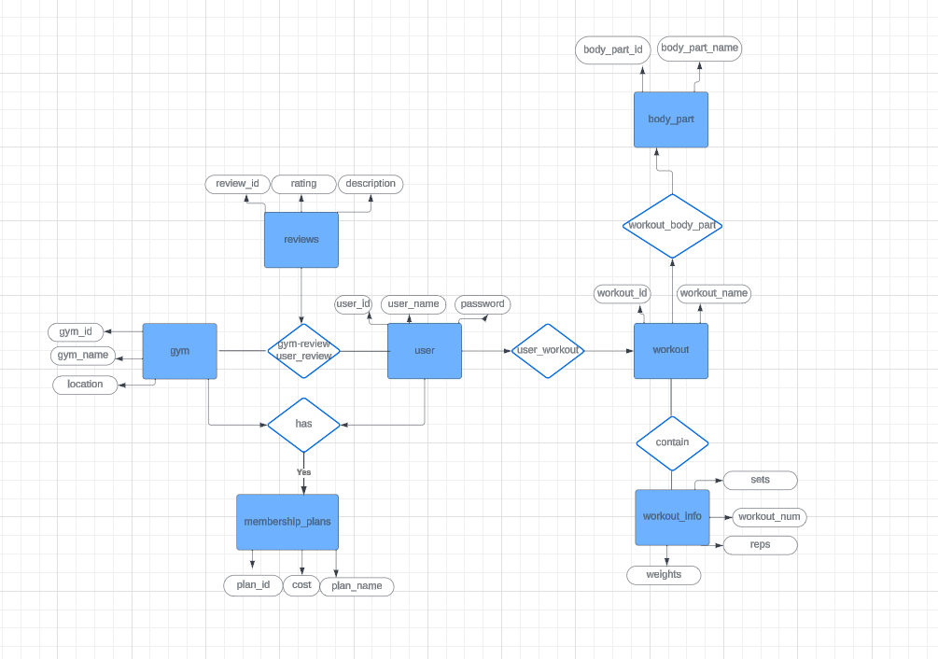
ER Diagrams

Slide 11
Testing
Creating Accounts
Adding Workouts
Adding Reviews
Trying to edit other review’s that the user didn’t make

Slide 12
Data Insertions
In my database I pre-filled out the body parts and the works that someone can choose from. As well as the gyms that people can review.
The rest of the inserts I did by just inserting the data on the actual website with different accounts.

